Slide 1
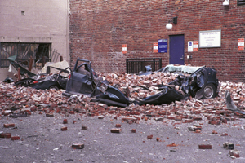
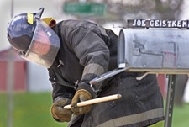
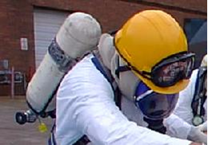
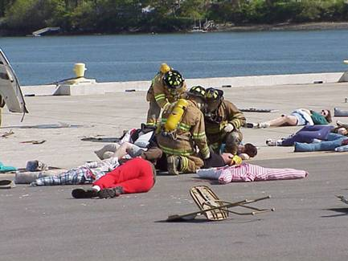
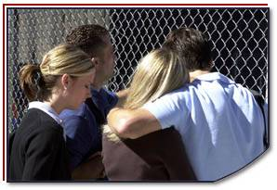
Disaster Site Worker Safety
Respiratory Protection

Slide 2
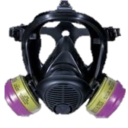
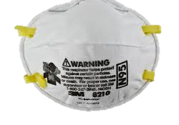
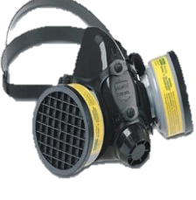
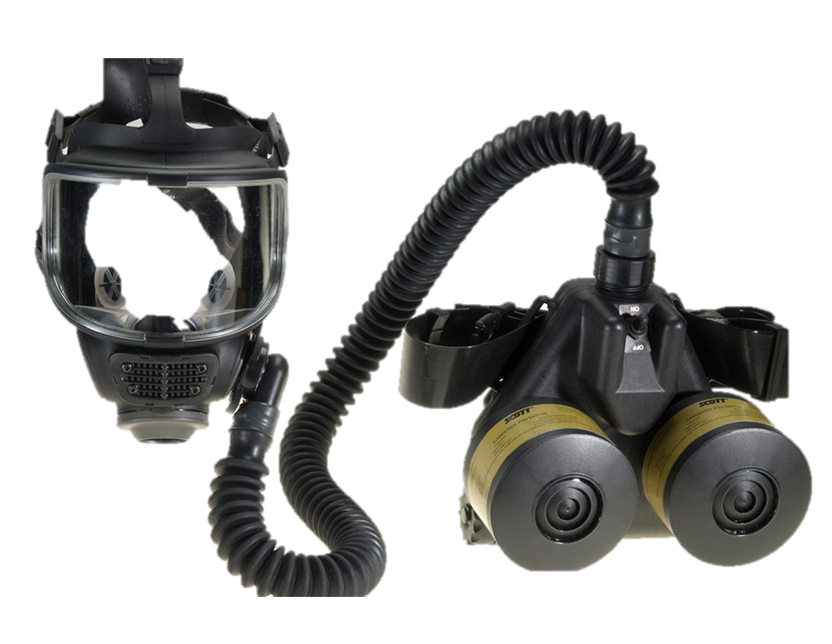
Objectives
Identify if an Air-Purifying Respirator (APR) is approved for use by the National Institute for Occupational Safety and Health (NIOSH).
List the limitations of APRs
List the types of APRs.
Describe some respiratory hazards.
Explain what must occur before a user can wear a respiratory protection device such as an APR.

Slide 3
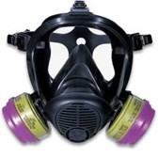
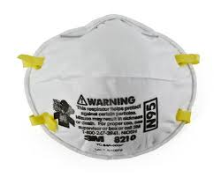
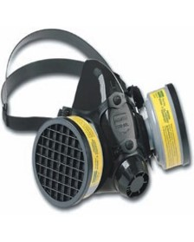
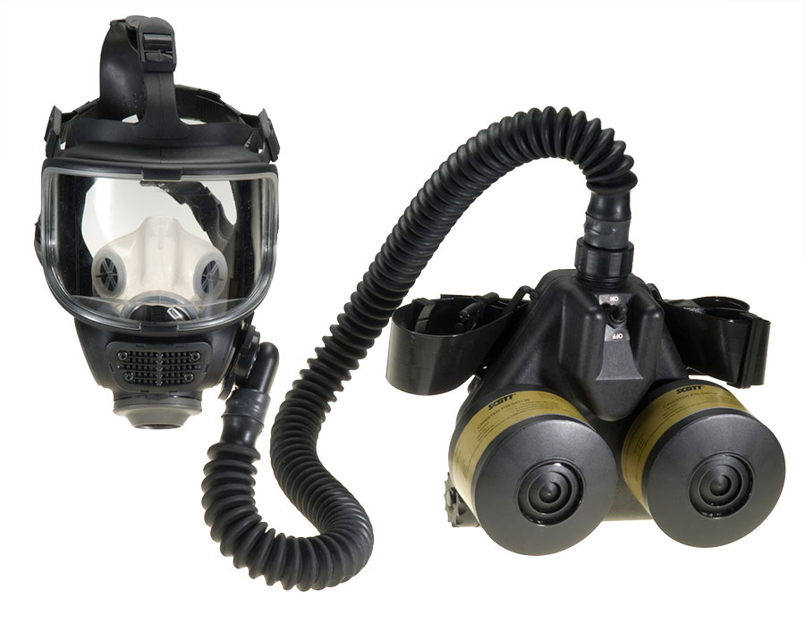
RESPIRATORY
Look back at your “Hazard Recognition & Assessment” work sheet in Module # 1.
Identify your Respiratory requirements.

Slide 4
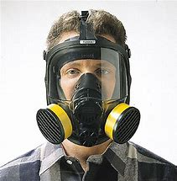
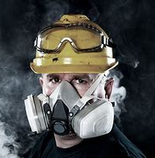
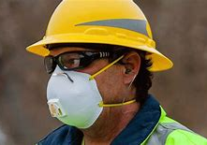
Respiratory Hazards
Dusts
Mists
Fumes
Gases
Vapors

Slide 5
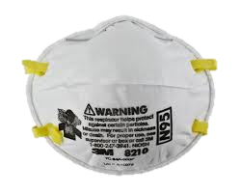
Respiratory Protection
Respiratory Protection
Respiratory protection is of primary importance since inhalation is one of the major routes of exposure to chemical and biological toxicants.
N95 Respirators
N95 respirator is a respiratory protective device designed to achieve a very close facial fit and very efficient filtration of airborne particles. 'N95' designation means that when subjected to careful testing, the respirator blocks at least 95% of very small (0.3 micron) test particles.

Slide 6
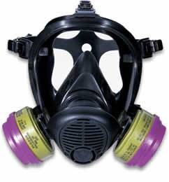
Respiratory Protection
Respiratory Protection
Air Purifying Respiratory protective devices (APRs) consist of a facepiece connected to an air-purifying device.
Air purifying device cartridge or canister must be carefully selected to match the airborne hazard present.
Incorrect selection could result in sickness and respiratory problems.

Slide 7
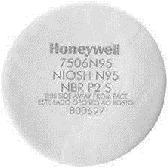
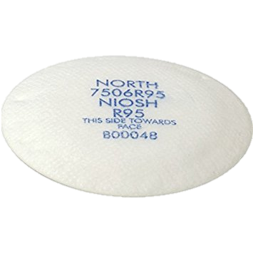
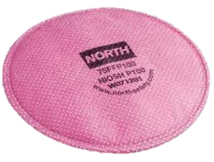
NIOSH Filter Classifications
PARTICULATE FILTERS
N - For solid particulates and non-oil aerosols that do not degrade filter performance.
R - For solid particulates and degrading oil based aerosols. R filters have "Use Limitations."
P - For solid particulates and degrading oil based aerosols. P filters have no "Use Limitations" other than those normally associated with particulate filters.
Three efficiency levels: 95%; 99%; 99.97%

Slide 8
NIOSH cartridge Classifications

Slide 9
Respiratory Protection
Powered Air Purifying Respirator (PAPR)
The PAPR equipment is battery operated, consists of a half or full facepiece, breathing tube, battery-operated blower, and particulate filters (HEPA only).
A PAPR uses a blower to pass contaminated air through a HEPA filter, which removes the contaminant and supplies purified air to a facepiece.

Slide 10
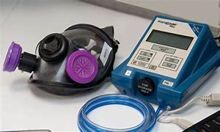
Respirator Use
Workers who are required to use respirators must be:
Medically evaluated to determine their ability to safely wear the respirator
Fit tested to ensure the respirator will provide adequate wear-time protection.
Trained such that they can demonstrate knowledge of at least why the respirator is necessary and how improper fit, use, or maintenance can compromise its protective effect
Proper respirator use includes adequate cleaning and inspection, donning, user seal checks, and doffing.

Slide 12
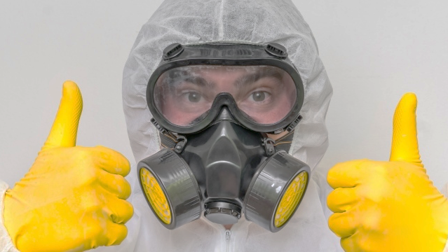
Respiratory
ACTIVITY
Inspect
Donning
User Seal
Doffing
Cleaning / Dispose

Slide 13
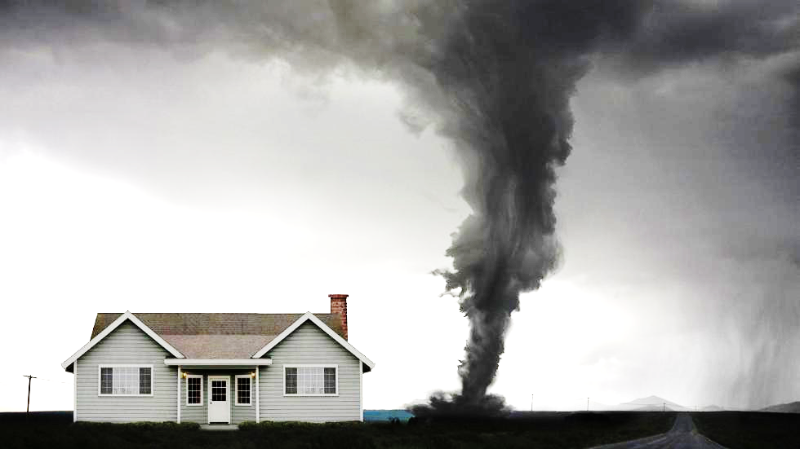
Dashboard
PPE

